Slide 1

CYBER SECURITY

Slide 2
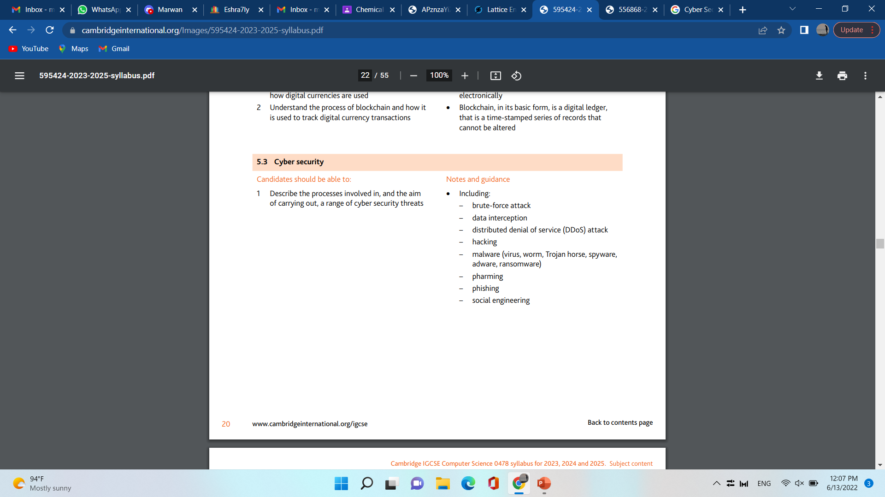
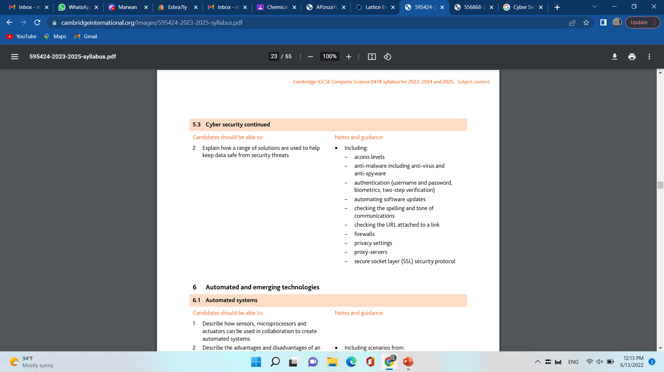
Syllabus overview

Slide 3
Cyber threats

Slide 4
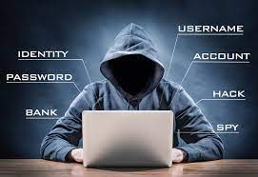
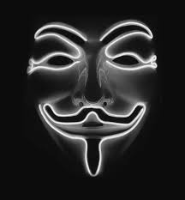
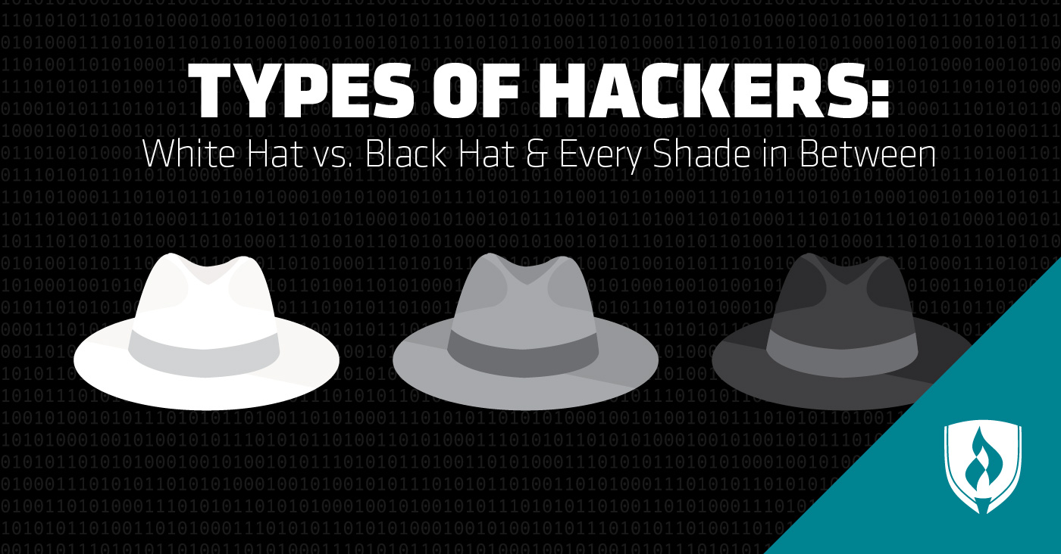
Hacking
Gaining unauthorized access to someone’s files.
Types of Hacking
White Hat
Black Hat
Grey Hat

Slide 5
Malware
A hacker hacked the network
Download a malware into the Computer (Malware could have been in a link)
Antimalware program not present/does not function.
As a result malware is not detected.
Examples of Malware (Virus and Spyware)

Slide 6
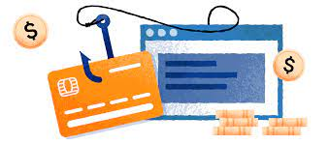
Pharming
An exciting looking website is presented
Offers desirable prizes and discounts that attracts victims.
May have a similar website presentation to a well known company
Asks for sensitive information

Slide 7

phishing
Exciting looking email is sent to a user
The user is encouraged to click on the link that is provided
Redirects user to an exciting looking email

Slide 8
Minimising cYBER threats

Slide 9

Antimalware
Antivirus program
Scans computer for a virus
Alerts user of virus being present
Quarantines the Virus
Removes the virus
Checks the data before being downloaded
Antispyware program
Scans the computer for a spyware
Alerts the user for presence of a spyware
Removes the Spyware
Checks the files for spyware before being downloaded

Slide 10
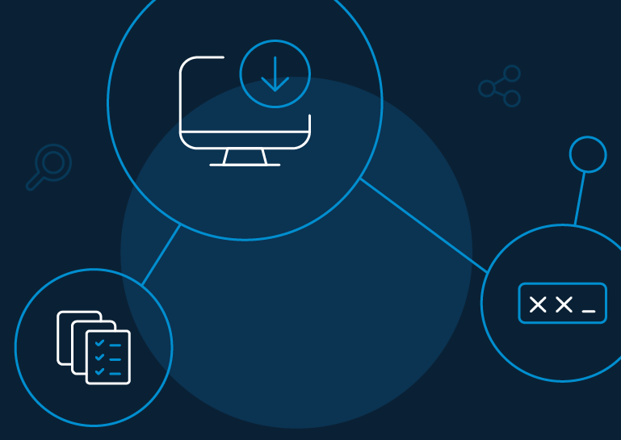
authentication
Strong Password (small letters, capital letters, numbers, symbols)
Do not use the same password for all accounts
Do not personalize the password
Biometrics (storing unique features of an individual)
Disable/alarm goes off after many failed trials
Two step verification

Slide 11
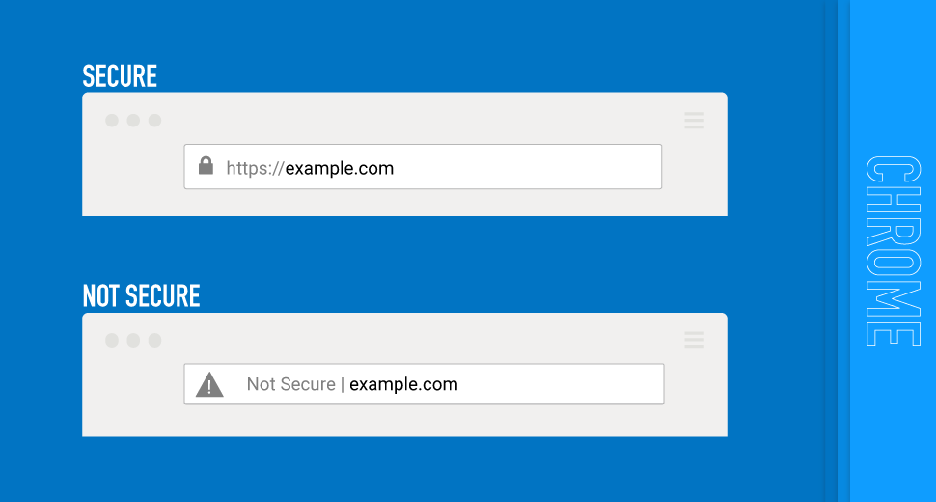


Checking the url
Authentic Websites
Unauthentic websites
Closed Padlock
No Padlock
HTTPS (Hyper Text Transfer protocol Secure)
HTTPS uses SSL and Encryption

Slide 12
Checking the spelling and tone of communication
Authentic Websites
Non-Authentic Websites
Website is continuously updated
Website is NOT continuously updated
ACCURATE spelling and Grammar
NON-ACCURATE spelling and Grammar

Slide 13
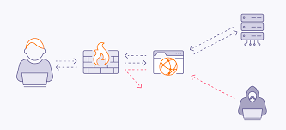
firewall
Monitors traffic coming into and out of the computer system
Checks that the traffic meets any rules set/criteria
Blocks the traffic that does not meet the criteria
Can set a blacklist and block the IP address
Close certain ports

Slide 14
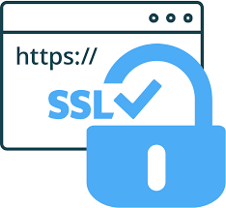
SSL (Secure socket layer)
Security protocol
Encrypts data sent
Digital certificates is sent to the browser
Contains the public key
The website is authenticated
Once the certificate is authenticated everything runs.

Slide 15
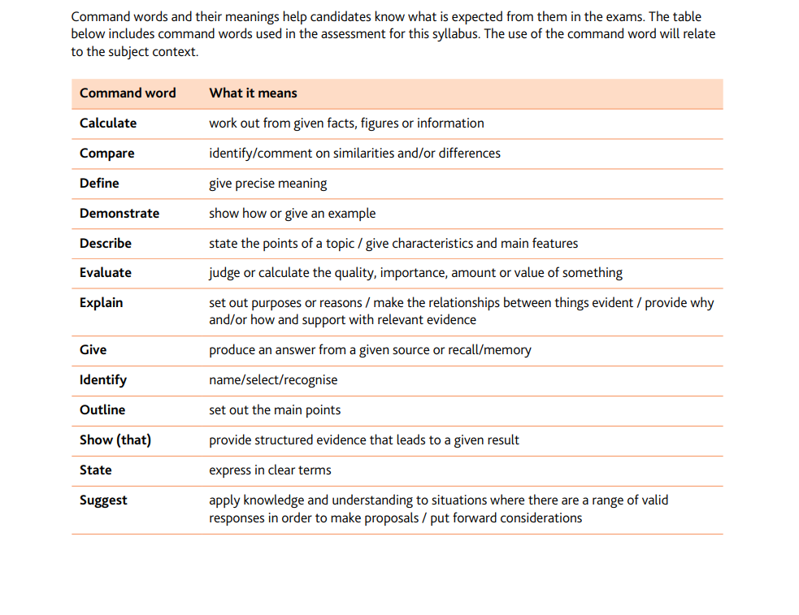
Command words

